Slide 1
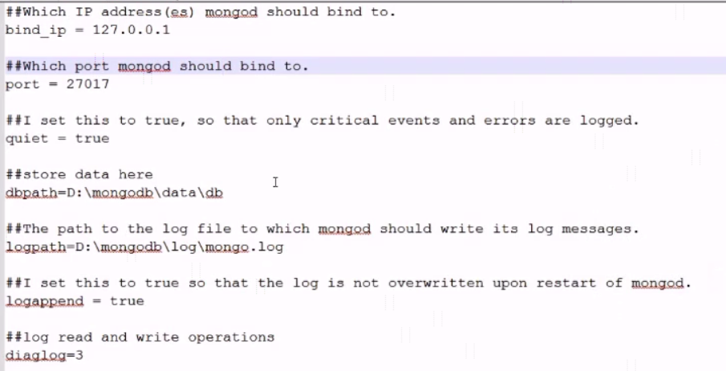
Configuring MongoDB server with configuration file

Slide 2
NoSQL(Not Only SQL) Database
E:\udemy\Learn MongoDB Leading NoSQL Database from scratch\[Tutsgalaxy.com] - Learn MongoDB Leading NoSQL Database from scratch\03 Getting Started - Installation Configuration

